Slide 1
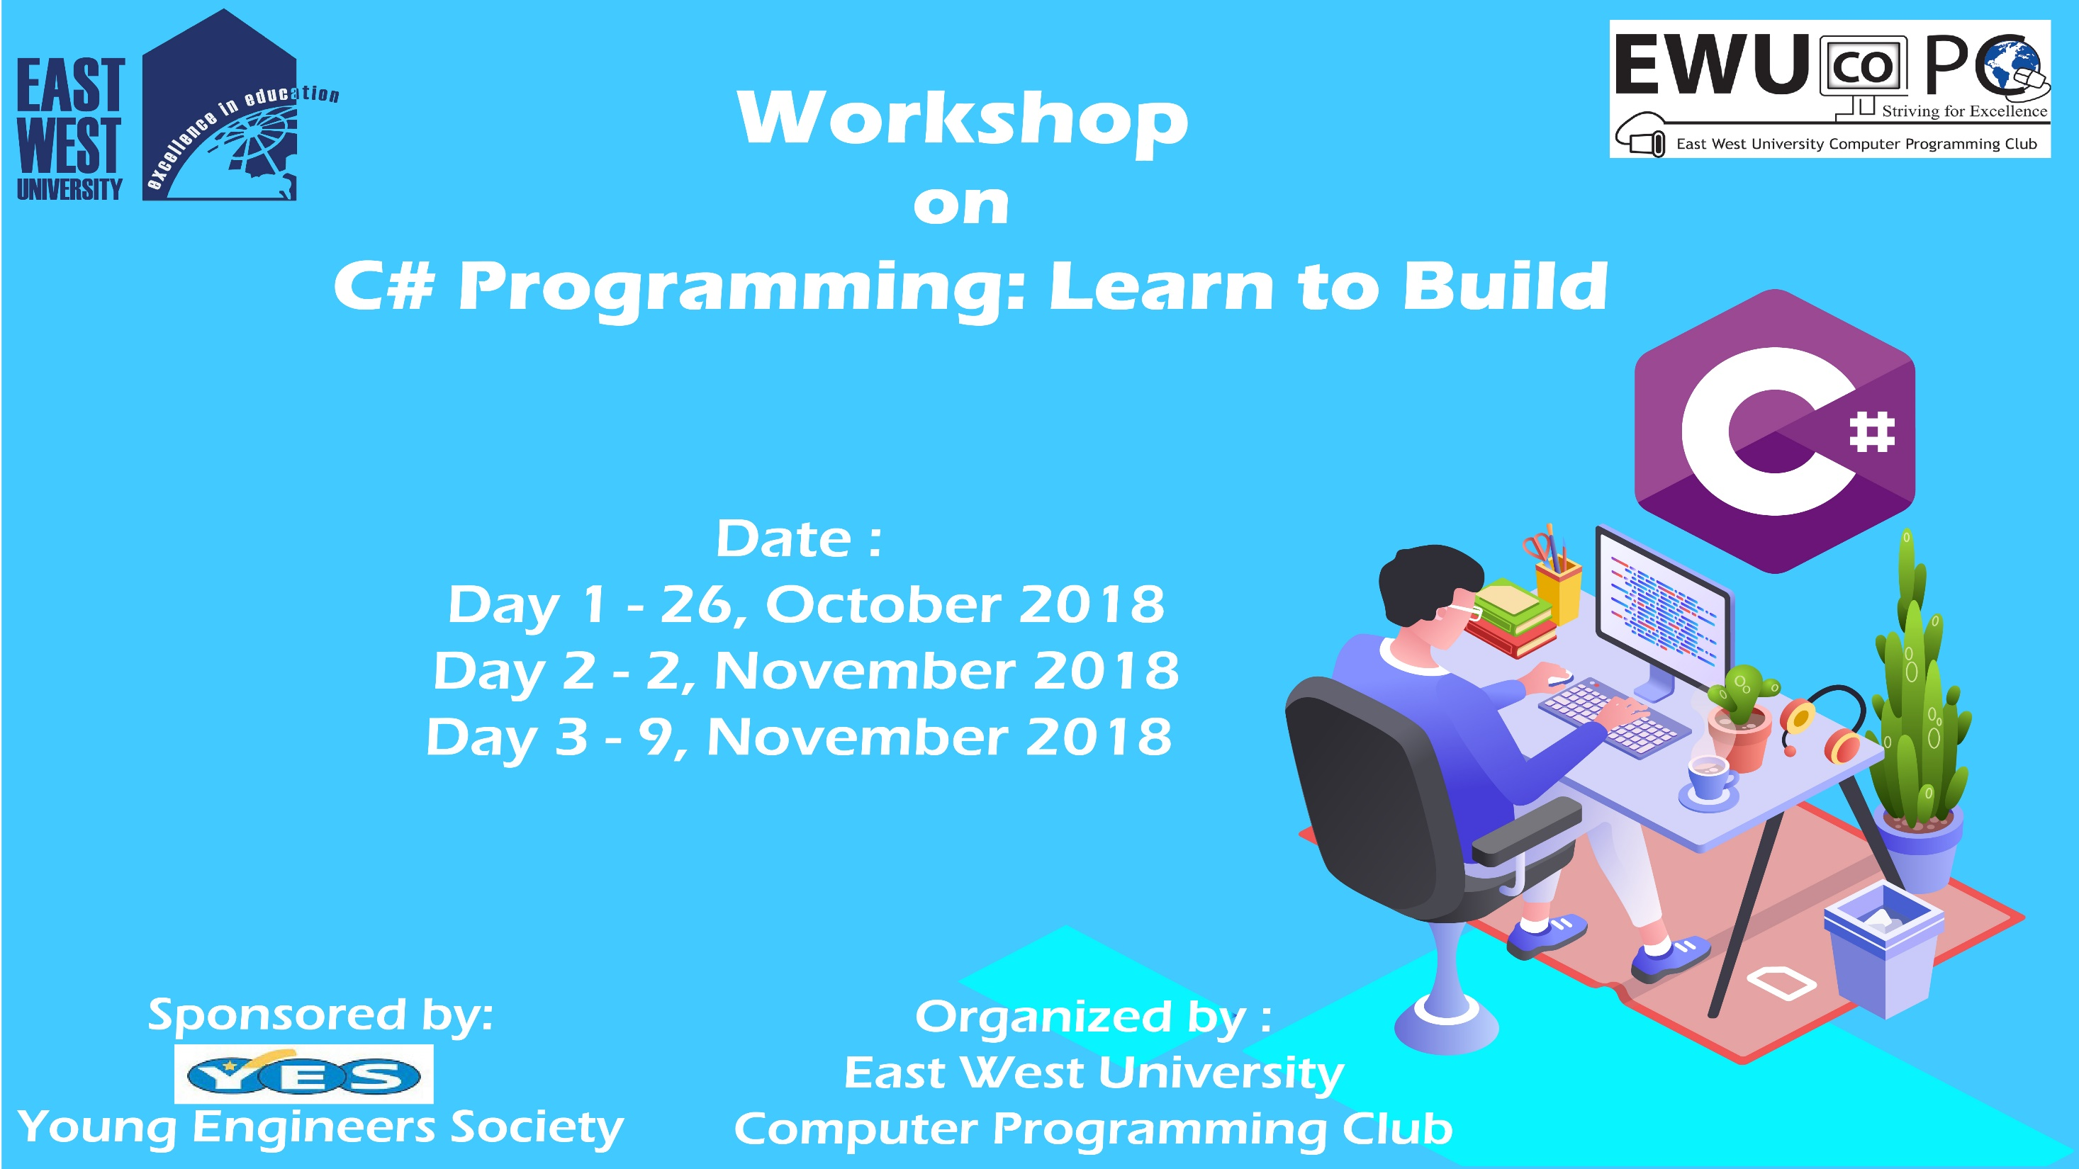

Slide 2
C# Day 1 Lecture5: Type Casting

Slide 3
Type Casting
using System;
namespace dataType
{
class Program
{
static void Main(string[] args)
{
int a = 1;
int b = 2;
short result = (short) (a + b);
Console.WriteLine(result);
Console.Read();
}
}
}

Slide 4
Type Casting
using System;
namespace dataType
{
class Program
{
static void Main(string[] args)
{
string String1 = "123";
int a = Int32.Parse(String1);
Console.WriteLine(a);
Console.Read();
}
}
}

Slide 5
Type Casting
using System;
namespace dataType
{
class Program
{
static void Main(string[] args)
{
string String1 = "123";
string String2 = "321";
int c = Int32.Parse(String1) + Int32.Parse (String2);
Console.WriteLine(c);
Console.Read();
}
}
}

Slide 6
Type Casting
using System;
namespace dataType
{
class Program
{
static void Main(string[] args)
{
string String2 = "321";
int b = Convert.ToInt32(String2);
Console.WriteLine(b);
Console.Read();
}
}
}

Slide 7
Type Casting
using System;
namespace dataType
{
class Program
{
static void Main(string[] args)
{
string String1 = "123";
string String2 = "321";
int c = Convert.ToInt32 (String1) + Convert.ToInt32(String2);
Console.WriteLine(c);
Console.Read();
}
}
}

Slide 8
Type Casting
using System;
namespace dataType
{
class Program
{
static void Main(string[] args)
{
string String1 = "123";
string String2 = "321";
int c = Int32.Parse.ToInt32 (String1) + Convert.ToInt32(String2);
Console.WriteLine(c);
Console.Read();
}
}
}

Slide 9
Type Casting
using System;
namespace dataType
{
class Program
{
static void Main(string[] args)
{
double d = 123.998;
int e = (int)d;
Console.WriteLine(e);
Console.Read();
}
}
}

Slide 10
Type Casting
using System;
namespace dataType
{
class Program
{
static void Main(string[] args)
{
string String1 = "123";
int a = Int32.Parse(String1);
object obj = a;
int r = (int)obj;
Console.WriteLine(r);
Console.Read();
}
}
}

Slide 11
This slide is provided as a course material in the workshop named “Workshop on C# Programming: Learn to Build”.
Organized by-
East West University Computer Programming Club (EWUCoPC)
Prepared by- Jannat Binta Alam
Campus Ambassador
Young Engineers Society (YES)
E-mail: jannat.cse.ewu@gmail.com

